Slide 1


Slide 2

LOOPS IN JAVASCRIPT

Slide 3
What Is A Loop ?
In programming, loops are used to execute the same block of code again and again, as long as a particular condition remains true.
The basic idea behind a loop is to automate the repetitive tasks within a program to save the time and effort.

Slide 4
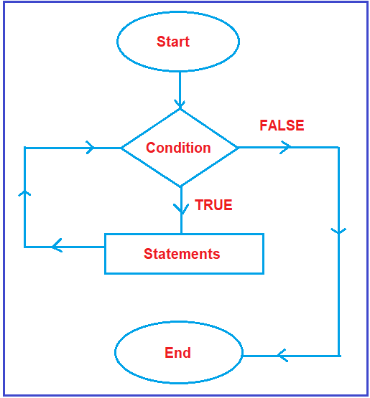
What Is A Loop ?

Slide 5
Types Of Loops In JS
JavaScript language supports following loops :
while :loops through a block of code while a specified
condition is true
do…while:also loops through a block of code while a specified
condition is true
for:loops through a block of code a number of times
for/in:loops through the arrays/objects
for/of: Newly introduced in ES6 and loops through the
values of an iterable like arrays

Slide 6
Syntax Of while Loop
while
while(<test cond>)
{
// loop body
}

Slide 7
PROGRAM
Write a JavaScript code to print first 10 natural numbers

Slide 8
PROGRAM
Write a JavaScript code to accept an integer from the user and print the table of that integer up to 10 terms

Slide 9
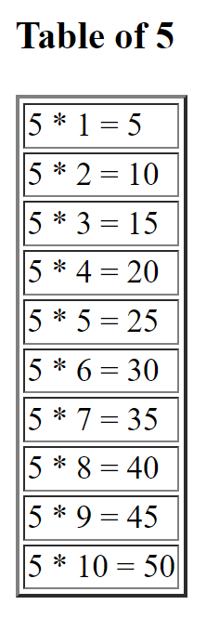
ASSIGNMENT
Modify the previous code so that output shown is as given below

Slide 10
Syntax Of do…while Loop:
do…while
do
{
// loop body
}while(<test cond>);

Slide 11
PROGRAM
Write a JavaScript code to continuously accept numbers from the user and as soon as 0 is entered show the sum and average of all the numbers inputted by the user

Slide 12
ASSIGNMENT
Write a JavaScript code to accept an integer from the user and calculate it’s factorial

Slide 13
ASSIGNMENT
Write a JavaScript code to accept the birth year from the user and calculate and print his age. Also print whether the user can vote or not . Make sure if the age turns out to be 0 or negative your code prompts the user to input his birth year again until the age comes positive

Slide 14
Syntax Of for Loop
for
for ( initialization; test_cond; stmt )
{
// loop body
}

Slide 15
PROGRAM
Write a JavaScript code to accept an integer from the user and calculate and print the sum of even and sum of odd nos up to the given no separately

Slide 16
Various forms of for loop :
for ( ; test_cond ; stmt )
{
// loop body
}

Slide 17
Various forms of for loop :
for ( ; ; )
{
// loop body
}
It is an infinite
loop

Slide 18
Various forms of for loop :
for ( ; ; )
{
// loop body
if( test_cond)
break;
// loop body
}

Slide 19
ASSIGNMENT
Write a JavaScript code to continuously accept numbers from the user and as soon as 0 is entered show the sum and average of all the numbers inputted by the user

Slide 20
Various forms of for loop :
for ( init1,init2; cond1 log_op cond 2; stmt1, stm2 )
{
// loop body
}

